Slide 1
Maximum Entropy (MaxEnt) model-based prediction of potential Southeastern Bering Sea (SEBS) krill distributions
December
2022
Sabrina Groves
Notes:
Hi my name is Sabrina Groves and today I’m going to be discussing several MaxEnt models for SEBS krill and the effects of environmental covariates on predicted distributions.

Slide 2
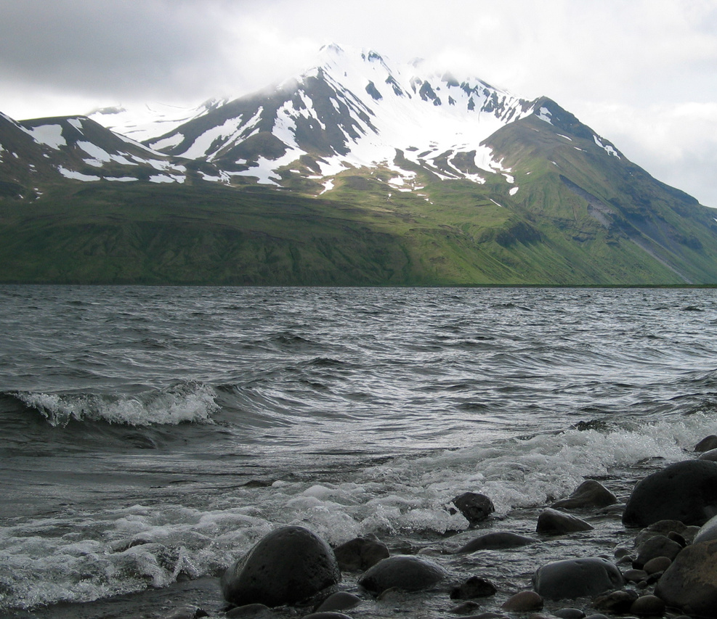
Introduction
Bering Sea supports a biodiverse community with immense ecosystem services
Krill are a crucial component of the ecosystem’s wasp-waist structure
Similar trophodynamics have catalyzed Antarctic krill standing stock policies
Notes:
The Bering Sea supports a biodiverse community with immense ecosystem services ranging from commercially important fish to internationally protected species. As a dominant mid-trophic zooplankton group, krill are a crucial component of the ecosystem’s wasp-waist structure, serving as intermediate heterotrophs that exert top-down controls on phytoplankton and micro-zooplankton while simultaneously applying bottom-up controls on marine mammals, sea birds, and fish. While similar trophodynamics have catalyzed stringent Antarctic euphausiid standing stock policies, the Bering Sea has yet to fully account for krill biomass and its large spatial and temporal variation, likely resulting in major knowledge gaps in the recruitment potential of commercially important fish and management of protected species.

Slide 3

Research Questions
Where are euphausiids found in the Southeastern Bering Sea?
What environmental conditions are strong predictors of krill presence?
Does the spatial extent of the cold pool correspond with predicted krill distribution?
Notes:
This research project will focus on where krill tend to be present and which environmental conditions serve as strong predictors of presence. Previous studies have reported that krill presence correlates with primary productivity, salinity, and temperature. In the Southeastern Bering Sea (SEBS), several additional factors may be influential. For instance, in large marine ecosystems, euphausiids aggregate within and adjacent to large shelf-incising submarine canyons. In the SEBS, three large marine canyons, Zhemchug, Pribilof, and Bering, cut into the edge of the continental shelf where upwelling and currents interact and enhance production. However, how these canyons affect euphausiid dynamics and why euphausiids tend to aggregate in these areas has not been explored. Another feature unique to the SEBS involves the cold pool, an area of below 2°C summer bottom water that influences heat diffusion and consequent metabolic rates of the SEBS’ inhabitants. Unlike bathymetric features, this area is seasonally governed and dynamic, potentially driving changes in krill distributions over time.
Research Question & Rationale
This study seeks to quantify combined krill distribution patterns in the Southeastern Bering Sea (SEBS) from 1993-2020 and identify potential environmental covariates driving spatial arrangements. Through this project, I hope to answer the following research questions:
Where are euphausiids found in the SEBS?
What environmental conditions serve as strong predictors of euphausiid presence?
Does the spatial extent of the cold pool correspond with predicted krill distribution?
Prediction Statements
For Questions 1-2) I predict that krill presence will be concentrated along the middle and inner domains of the SEBS. Two-dimensional space (latitude, longitude) coupled with corresponding ocean depth, chlorophyll A concentration, and sea surface temperature will serve as the predictors and euphausiid relative occurrence rate (ROR produced by MaxEnt model) will be the response variable. The middle and inner domains are likely favorable due to their high nutrient contents, moderate temperatures, and propensity for wind-induced upwelling, which facilitates higher diel vertical migrations. Chlorophyll A and bathymetry will serve as proxies for upwelling. These variables do not exhibit multicollinearity according to their variance inflation factors (VIFs).
For Question 3) I predict that the cold pool extent (approximated using the centroid, area, and fragmentation) will overlap with the highest maxent-predicted krill ROR due to the colder water’s advantageous lowering of the metabolic rate. Cold pool extent will serve as a predictor and krill coordinates at max ROR as the response variable.

Slide 4
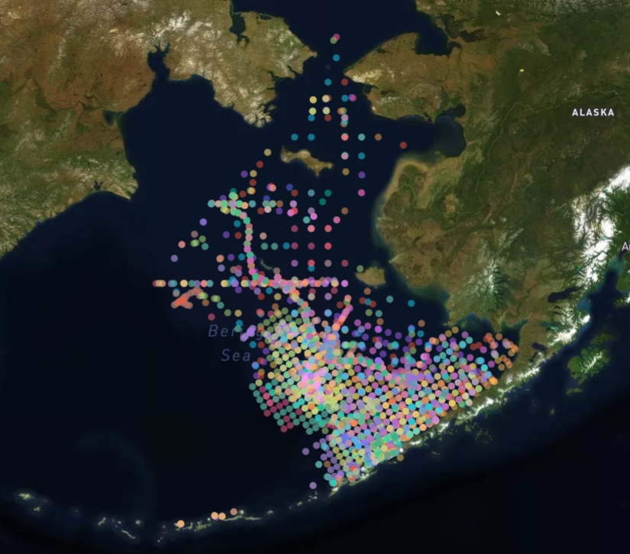
Methods: Krill Thinning
Goal: mitigate spatial and temporal autocorrelation
Krill bongo net samples were temporally and spatially biased the biased boat track and non-random sampling
To mitigate these effects and satisfy MaxEnt normality assumptions: krill were binned into sequential five-year periods
Bins were thinned by a step size of 50 square units between nearest neighbors on the x-y plane
Normality of the original and thinned distributions were assessed using QQ-plots and the Shapiro-Wilk’s test for normality
Notes:
Krill bongo net tows were conducted by the EcoFoci program, in partnership with NOAA, throughout the months of February-October from 1993-2020. The boat tracks were nonrandom and exhibit high degrees of spatial and temporal autocorrelation. Crew members recorded krill density at variable distance tows, leading depth and precise catch location to be unavailable. Although krill density is reported, bongo nets are not considered scientifically valid for krill density counts, as they have high incidences of escape. Instead, counts are traditionally treated as presence-only or presence and pseudoabsence, with absences potentially due to no krill, unsampled depth, or escape.
Raw krill sampling data was documented in R using the geojson, raster, terra, st, and sf packages to segment the sample space into three canyon-defined regions (Figure 1) and bin points into larger 1-degree squared segments for evaluation of sampling density. This data was then fed into Python’s Jupyter Notebook for interactive visualization using the plotly, pandas, chart_studio, and mapbox libraries. Interactive elements are facilitated by HTML, CSS, and JavaScript.
The interactive map was used to visualize clustering with different potential arrangements to avoid dense sampling patches and sparse areas of inactivity (Figure 2). To mitigate these effects and satisfy MaxEnt normality assumptions: krill were binned into sequential five-year periods, bins were thinned by a step size of 50 square units between nearest neighbors on the x-y plane, and normality of the original and thinned distributions were assessed using QQ-plots and the Shapiro-Wilk’s test for normality (Figures 2-10). The following slides will depict this process.

Slide 5
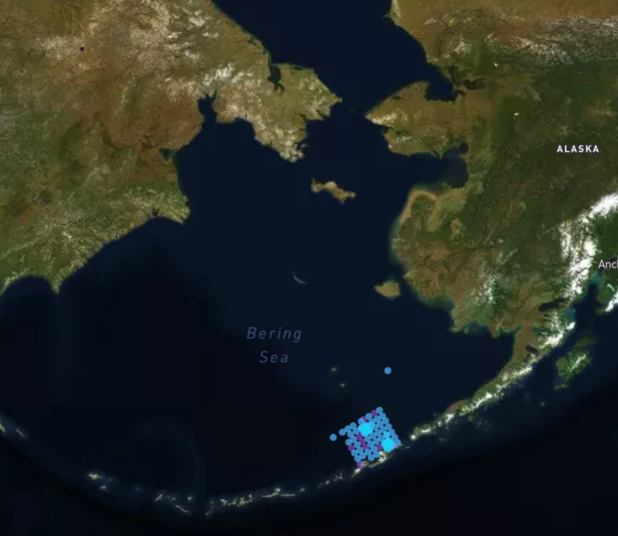
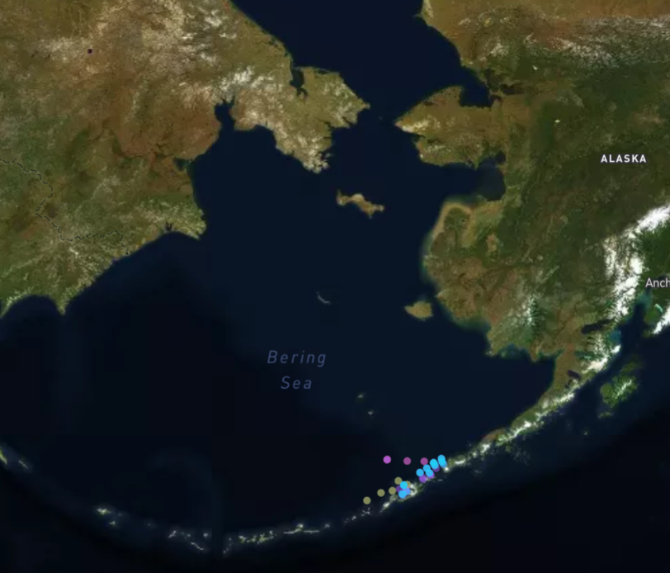
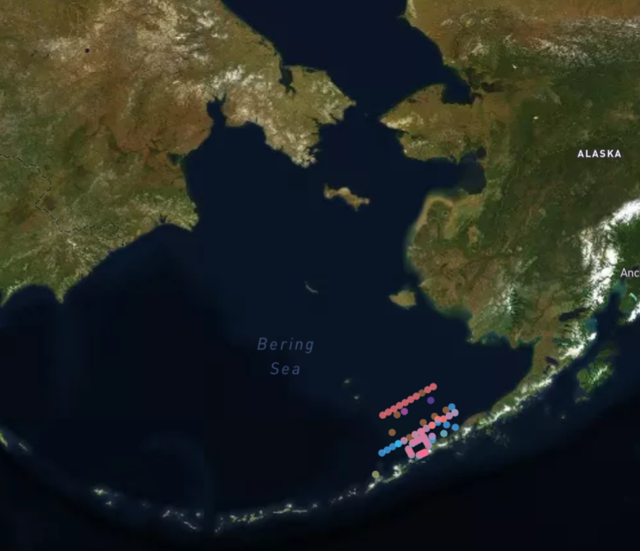
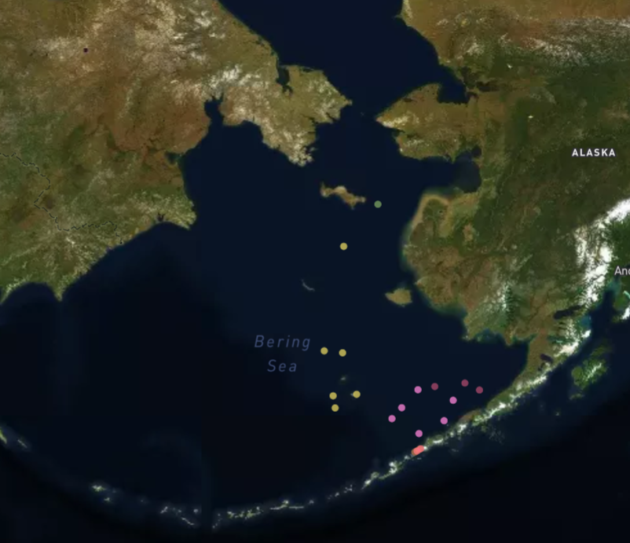
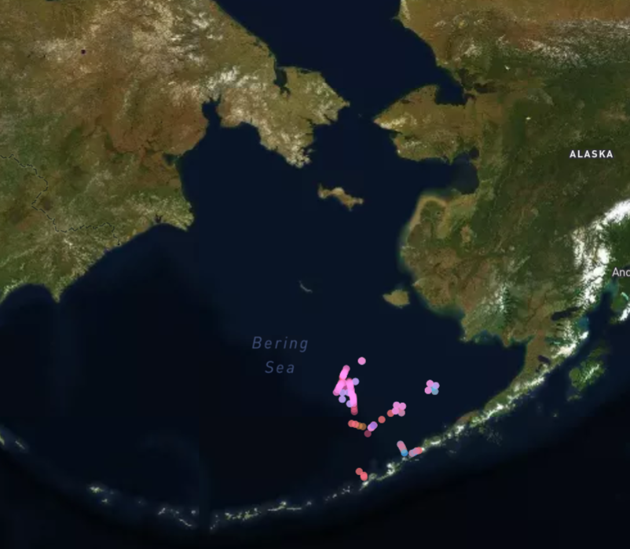
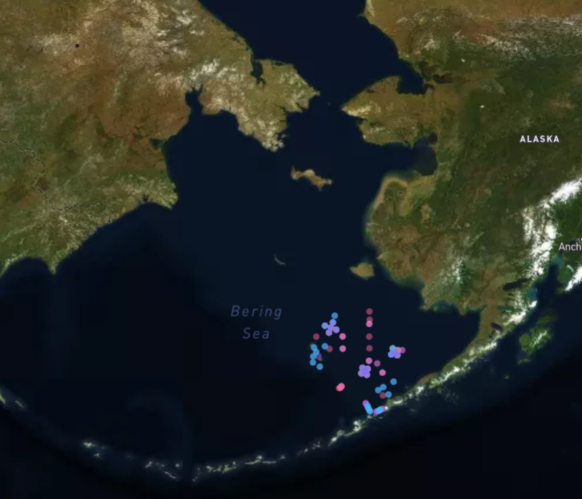
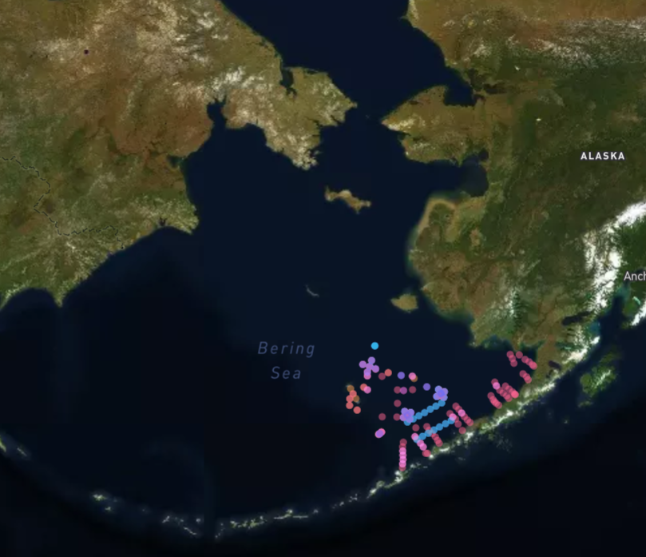
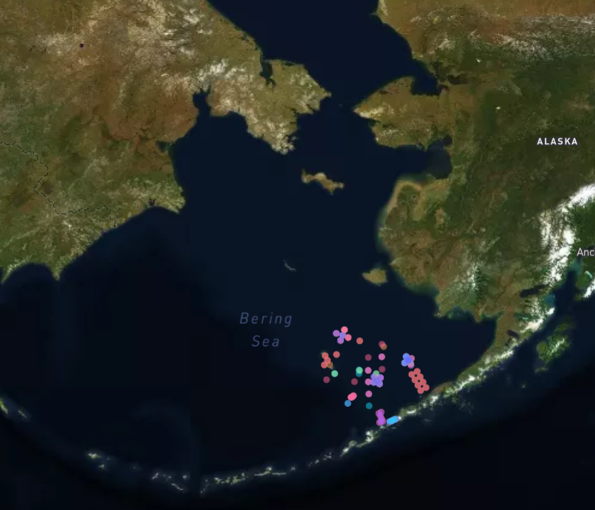

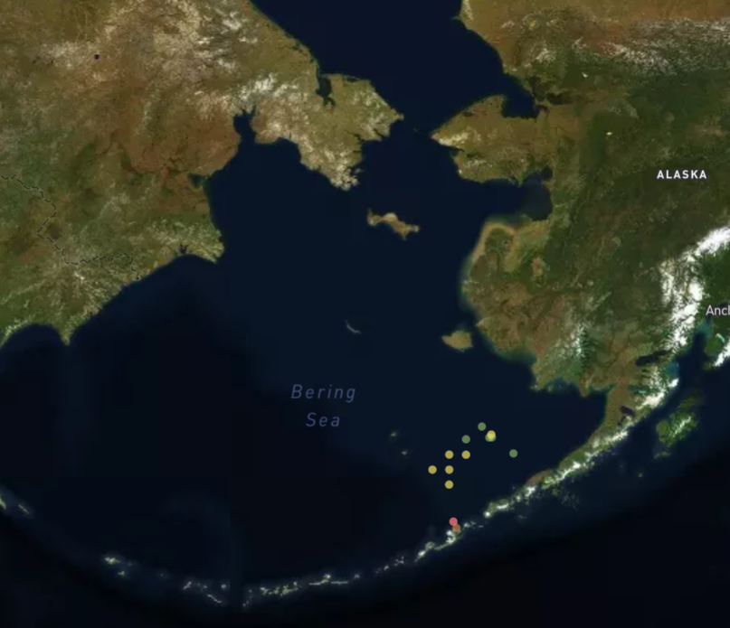
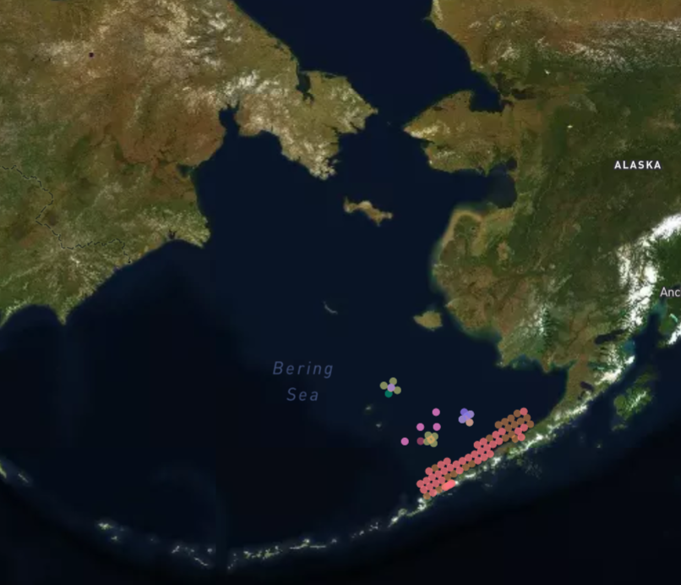
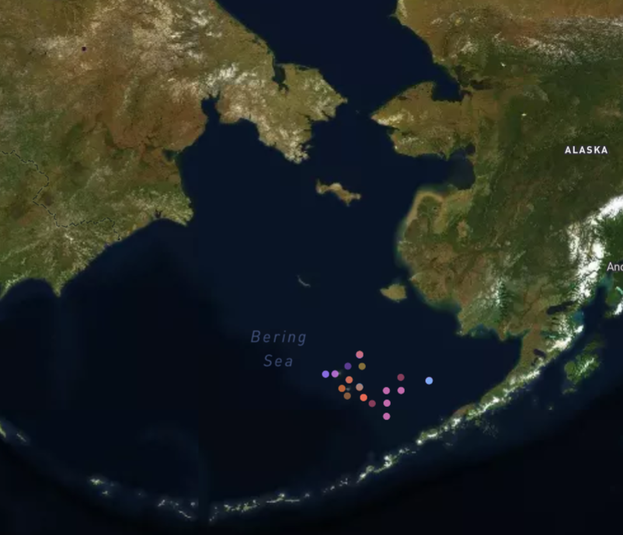
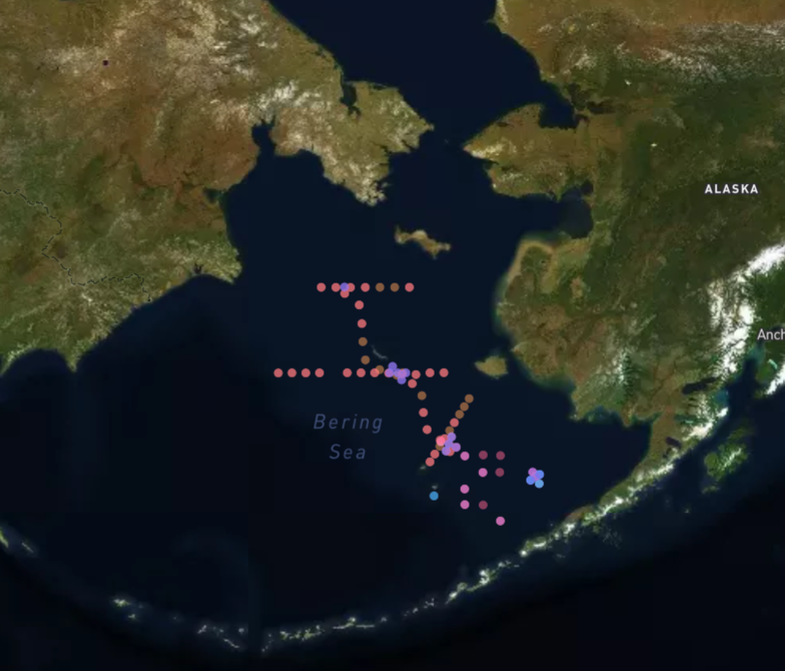
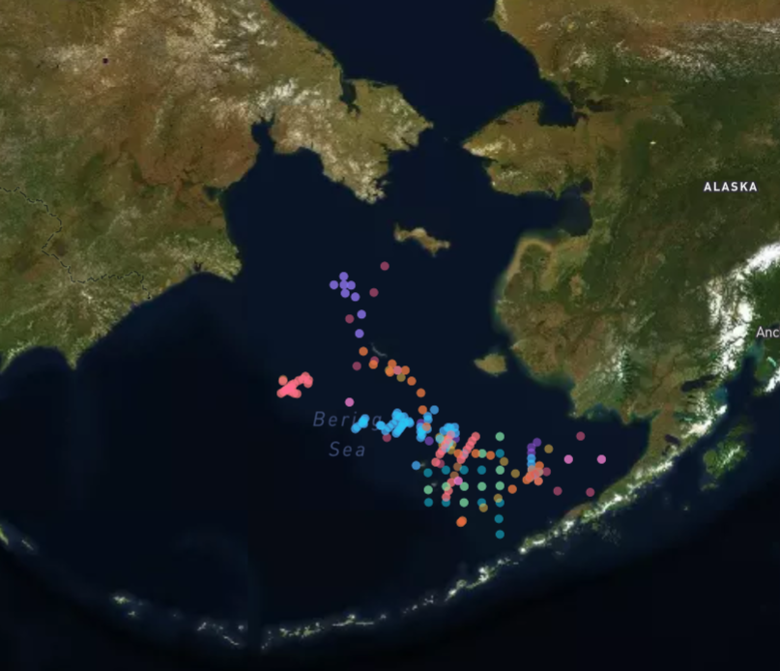
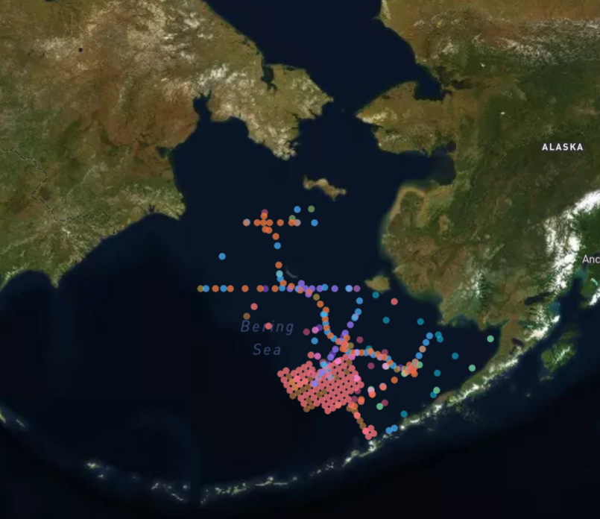
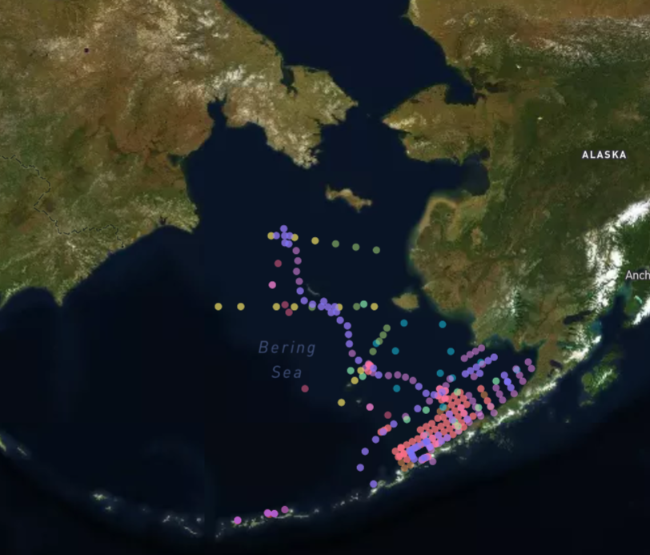
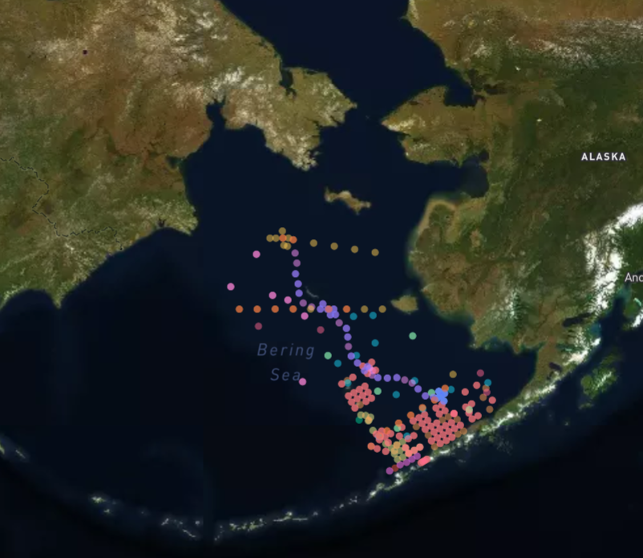
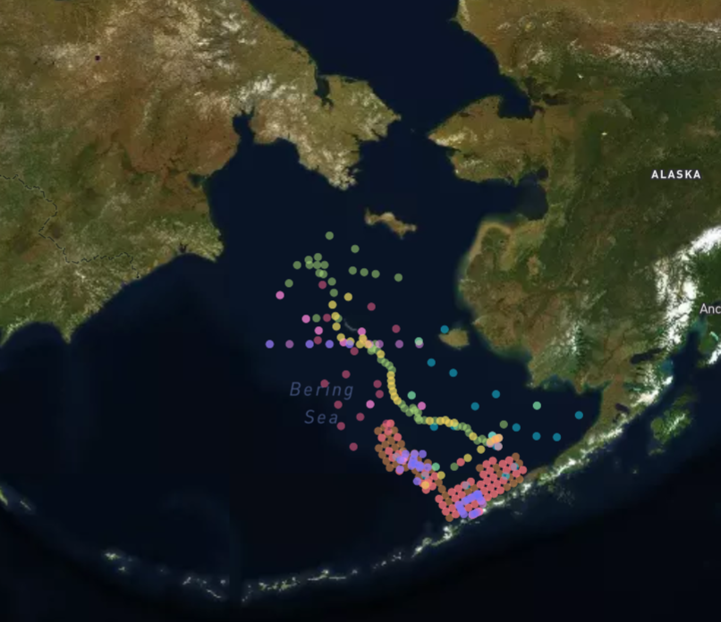
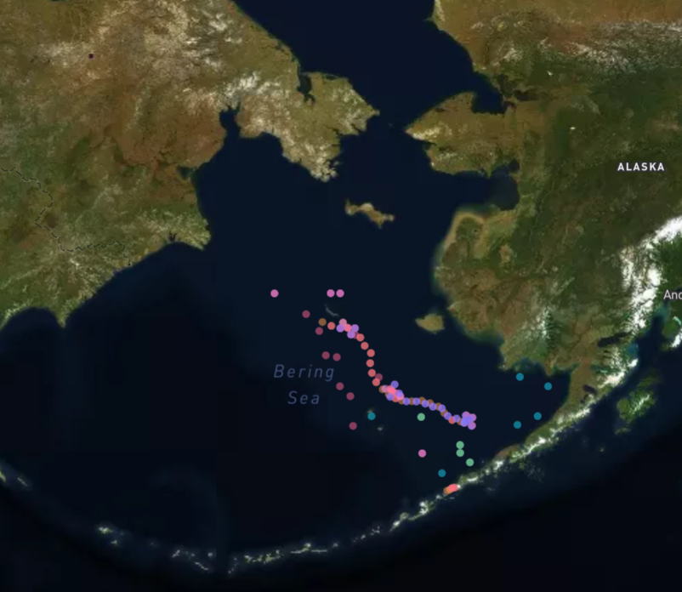
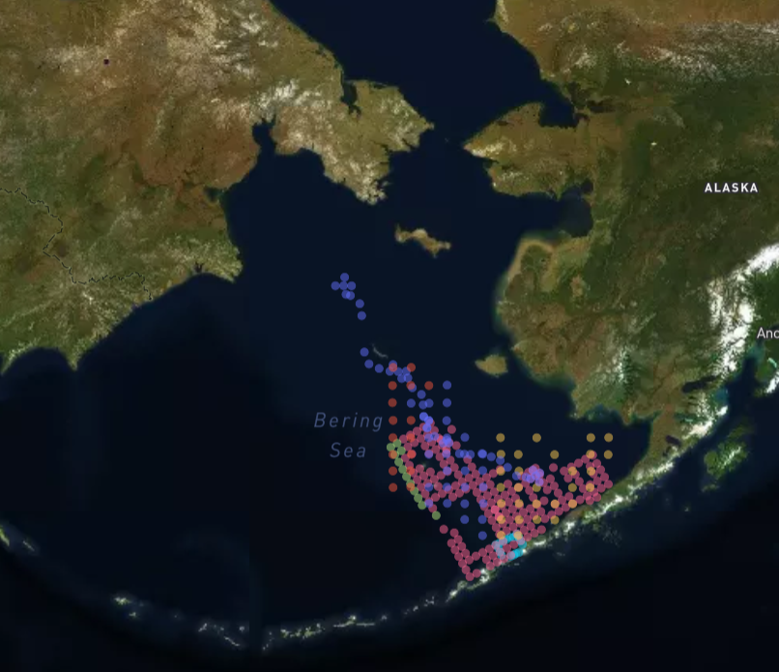
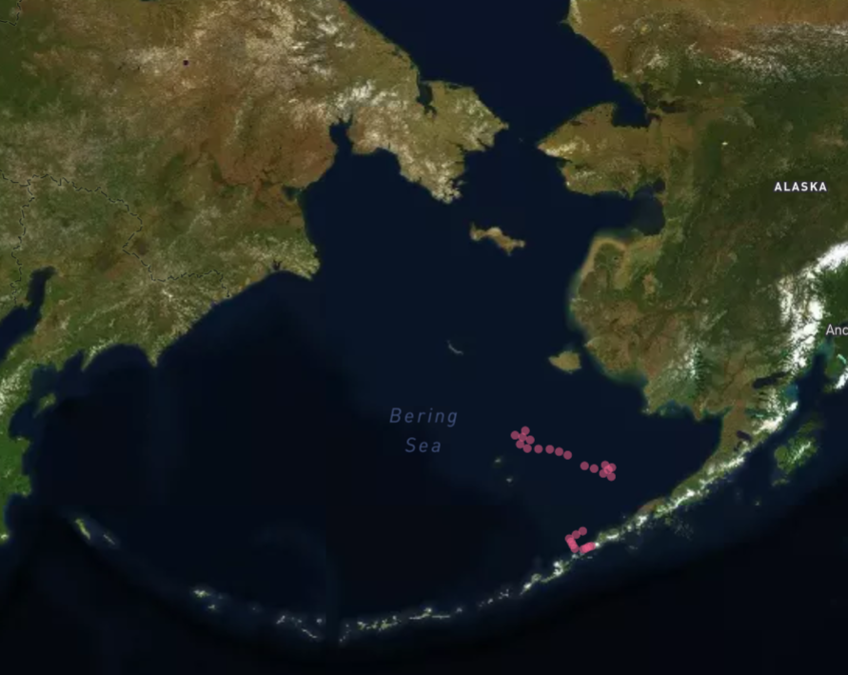
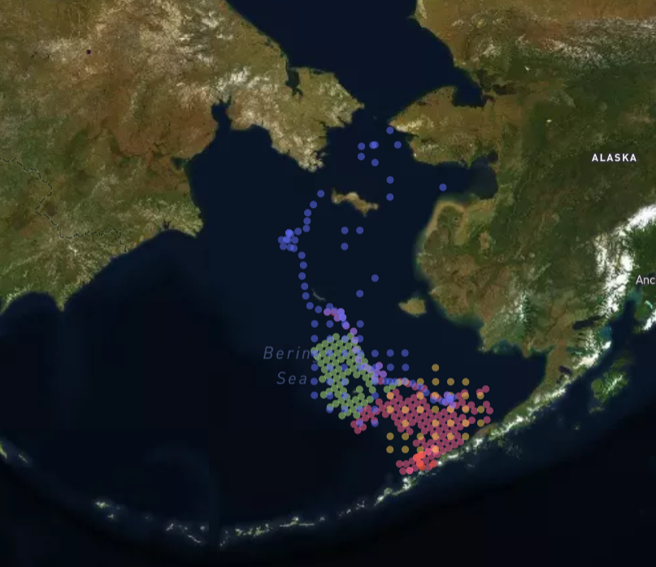
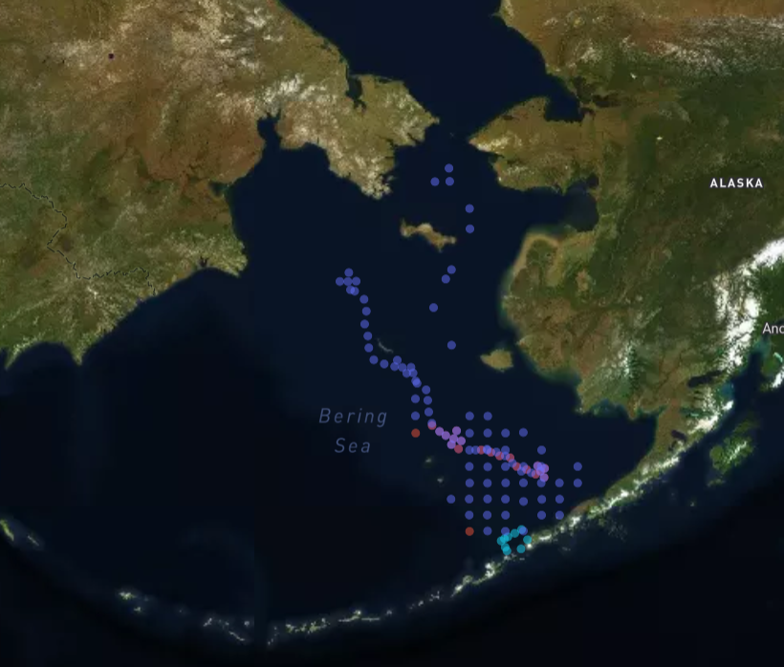
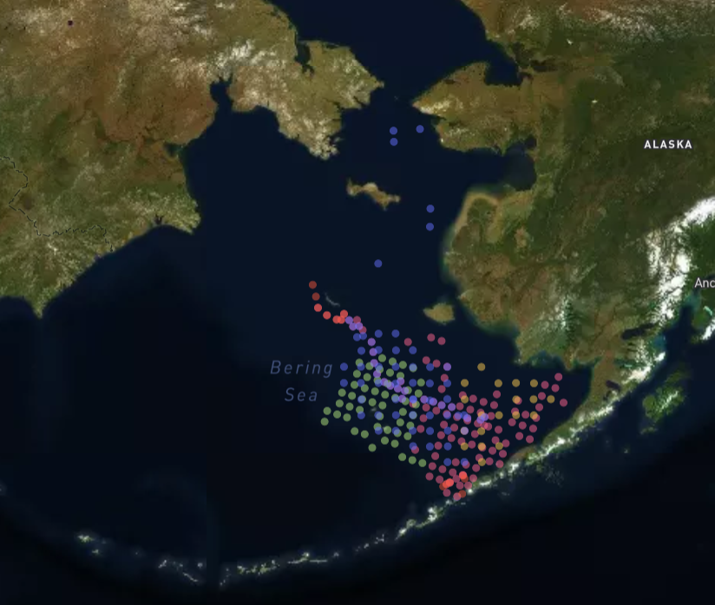
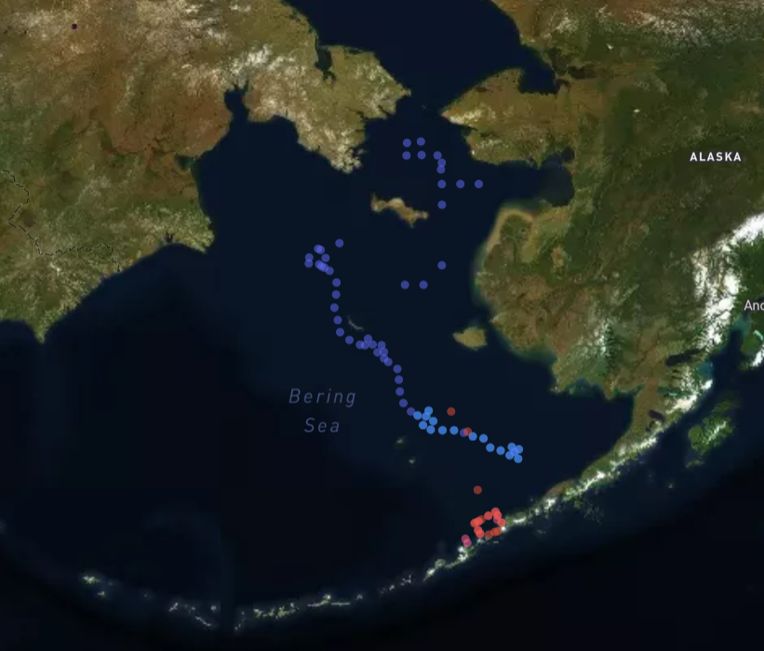
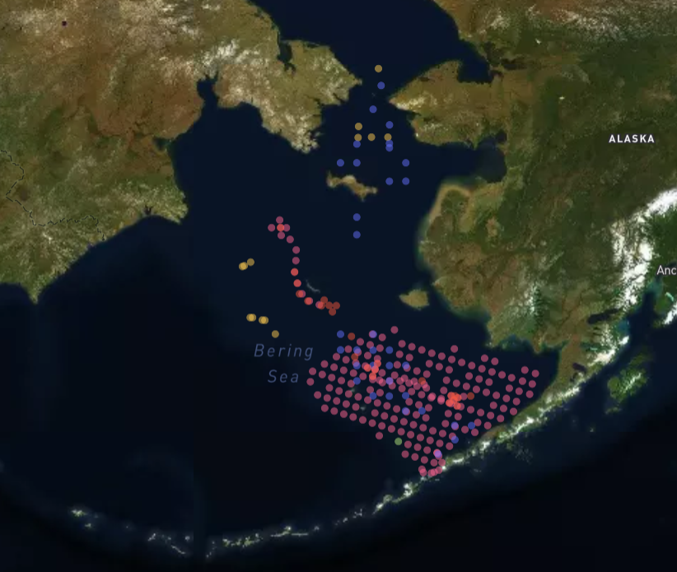
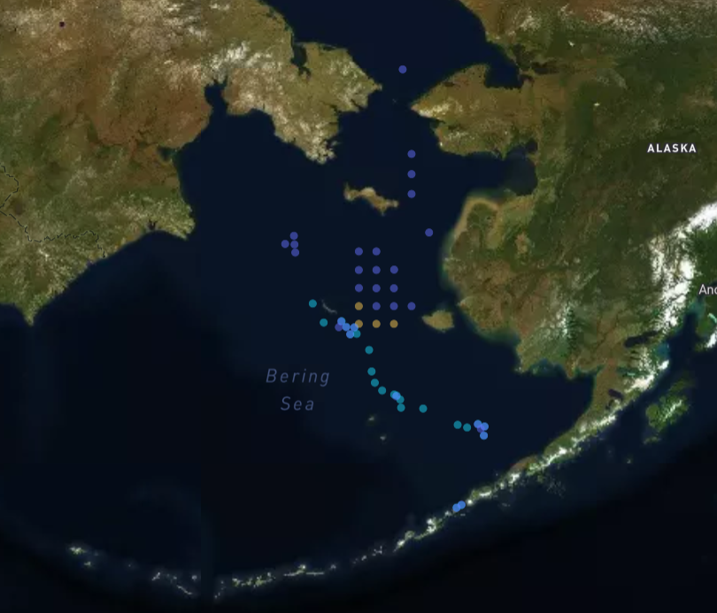
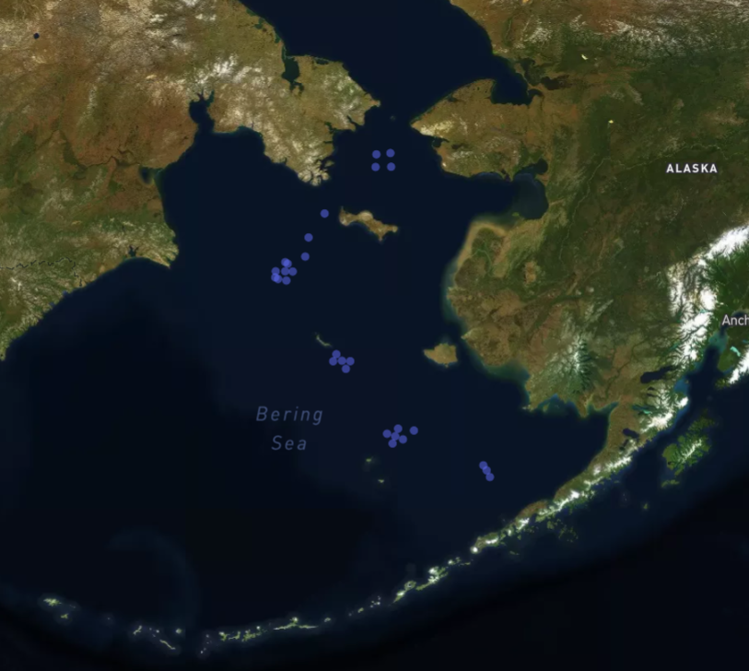
Krill Sampling
1993
1994
1995
1996
1997
1998
1999
2000
2001
2002
2003
2004
2005
2006
2007
2008
2009
2010
2011
2012
2013
2014
2015
2016
2017
2018
2019
2020
Notes:
Here you can the sampling distribution organized by years and colored by months. We notice that the early years exhibit sampling primarily concentrated in the southeast and sampled within the same couple months. In later years, sampling expanded to include areas of the northwest and months across the entire seasonal spectrum.

Slide 6
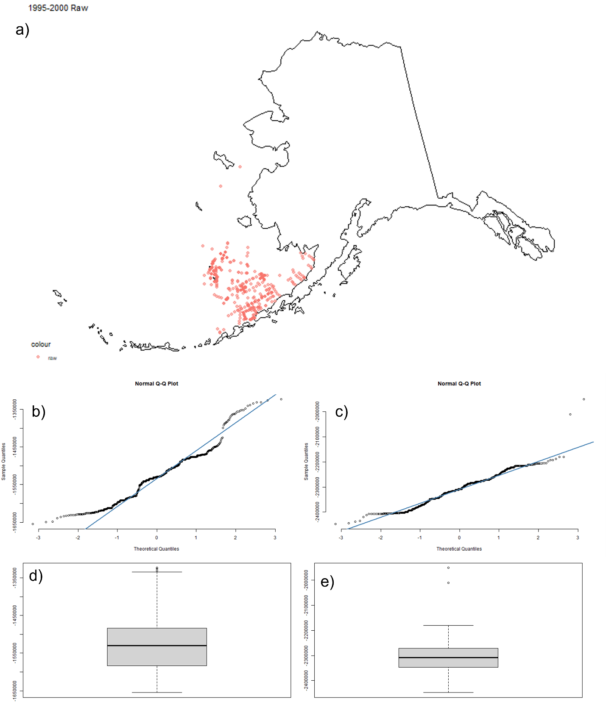
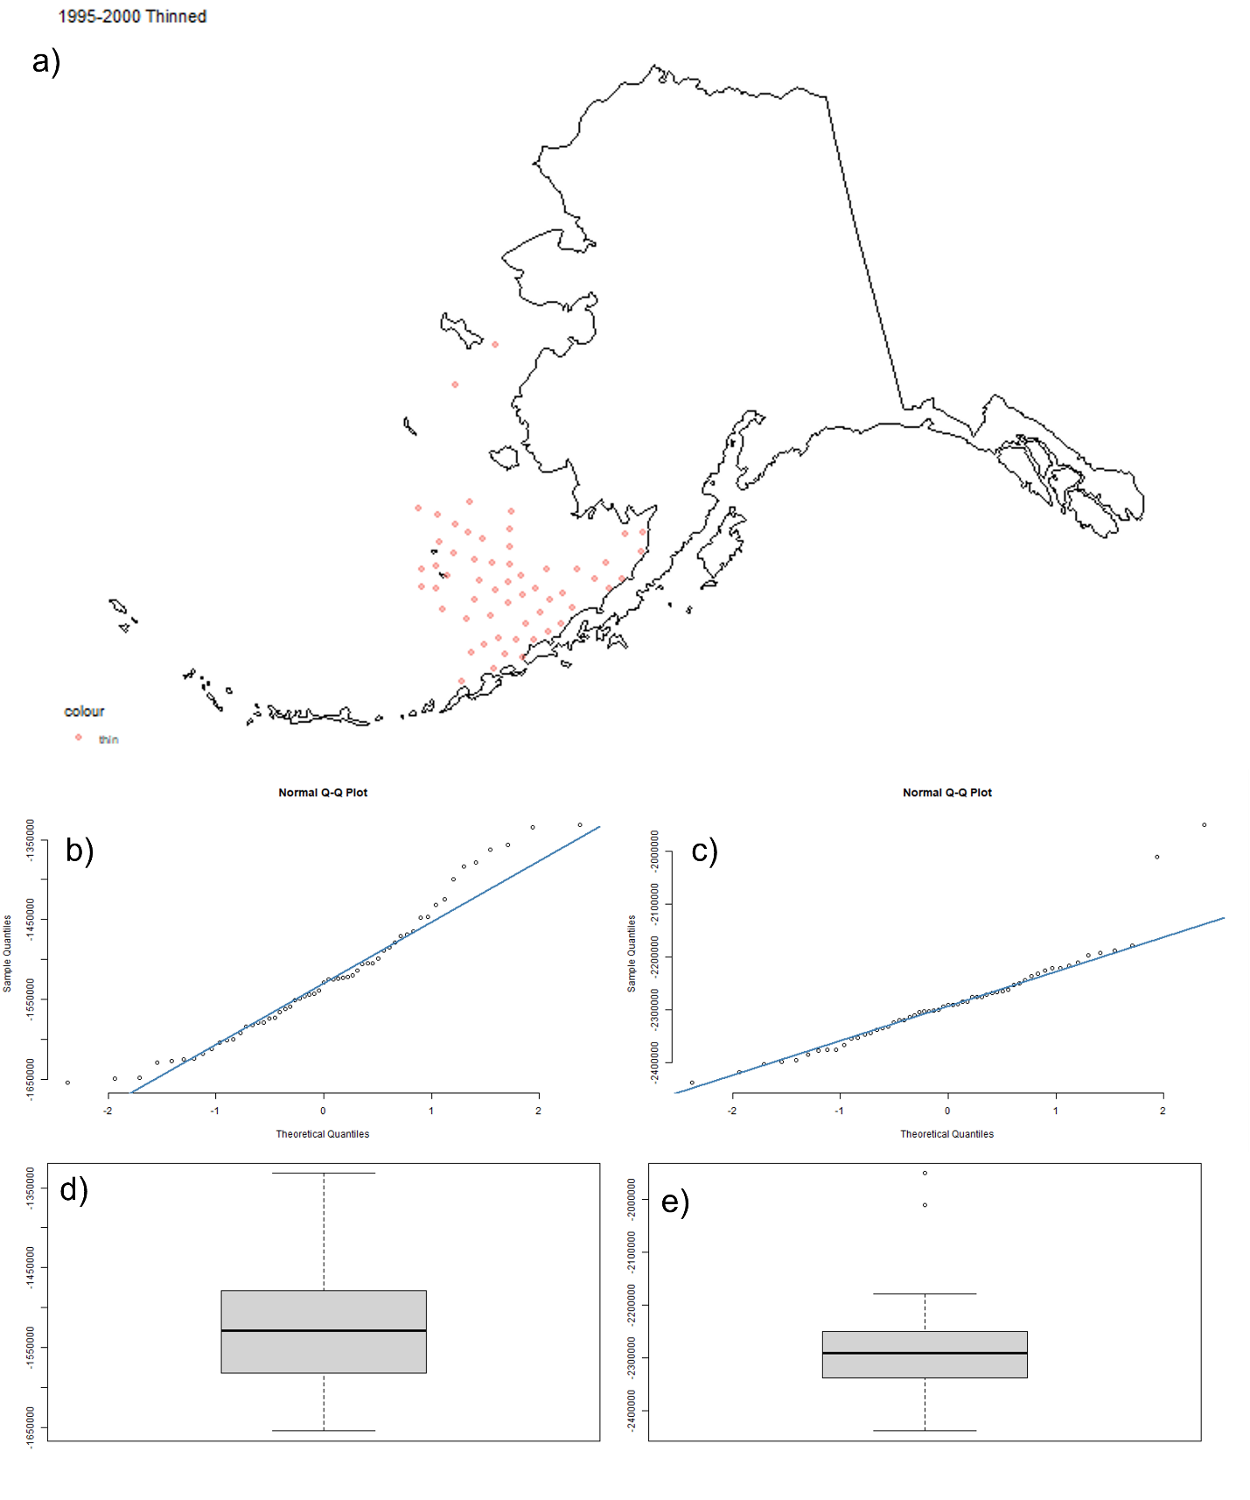
1995-2000
Notes:
The next slides show the original krill samples on the left and thinned krill samples on the right. Each slide features a sequential five-year binning period. Here we can see the 1995-2000 samples on map a, the QQ plots for x (b) and y (c) coordinates in the middle of the screen, and x and y coordinate boxplots with outliers as points on the bottom.
Figure 3: a) 1995-2000 raw krill samples; b) x-coordinate QQ plot; c) y-coordinate QQ-plot; d) x-coordinate boxplot; e) y-coordinate boxplot. Shapiro-Wilk Normality Test: p(x)=3.025e-12; p(y)=3.253e-11.
Figure 4: a) 1995-2000 thinned krill samples; b) x-coordinate QQ plot; c) y-coordinate QQ-plot; d) x-coordinate boxplot; e) y-coordinate boxplot. Shapiro-Wilk Normality Test: p(x)=0.03139; p(y)=0.000137.

Slide 7
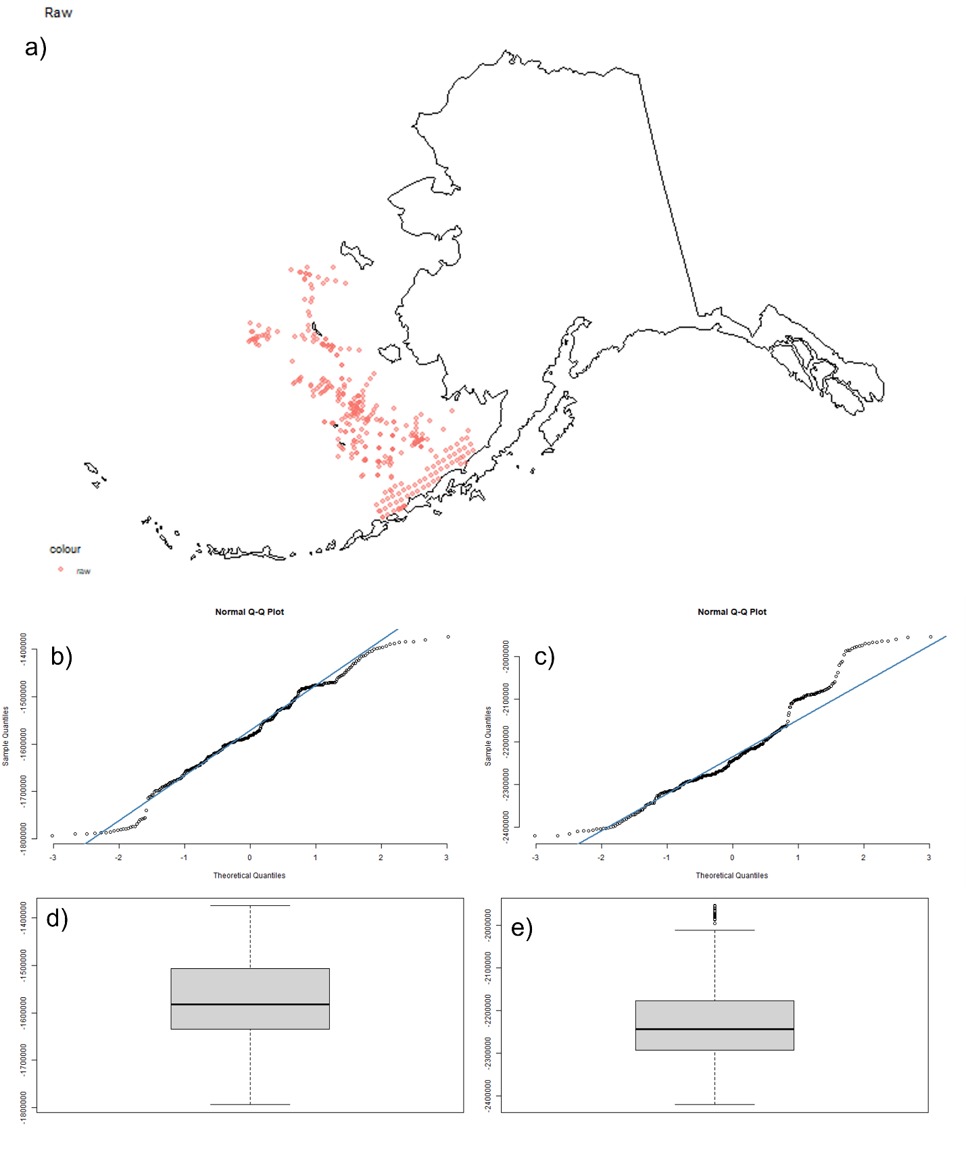

2001-2006
Notes:
Figure 5: a) 2001-2006 raw krill samples; b) x-coordinate QQ plot; c) y-coordinate QQ-plot; d) x-coordinate boxplot; e) y-coordinate boxplot. Shapiro-Wilk Normality Test: p(x)=0.0003807; p(y)=1.844e-09.
Figure 6: a) 2001-2006 thinned krill samples; b) x-coordinate QQ plot; c) y-coordinate QQ-plot; d) x-coordinate boxplot; e) y-coordinate boxplot. Shapiro-Wilk Normality Test: p(x)=0.685; p(y)=0.005392.

Slide 8
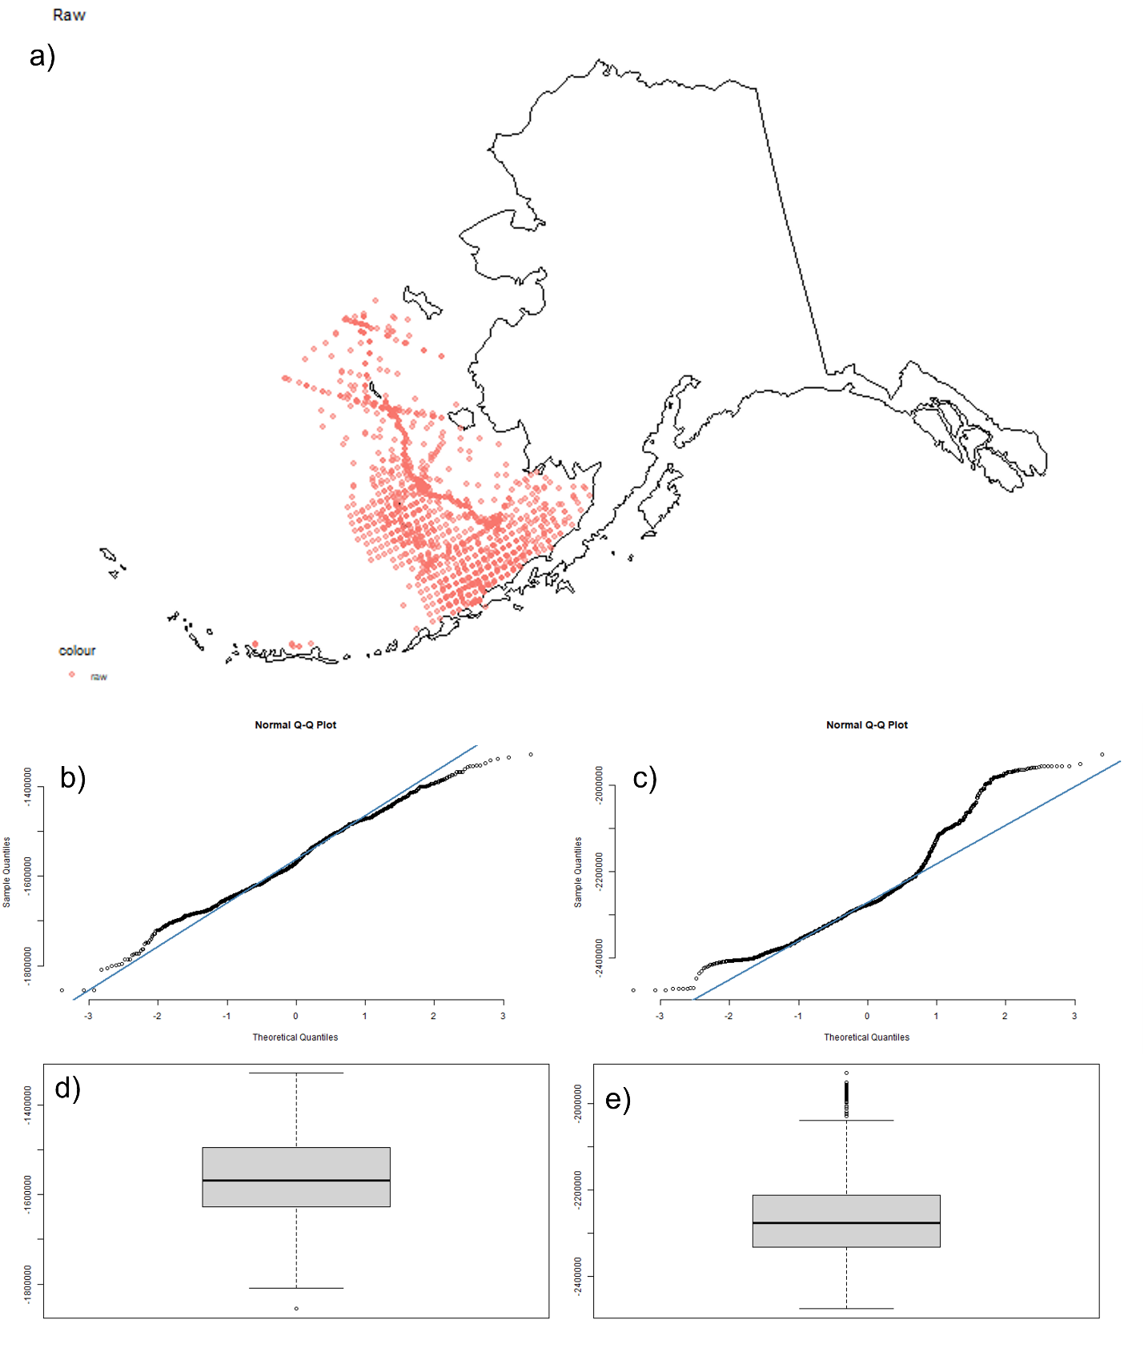
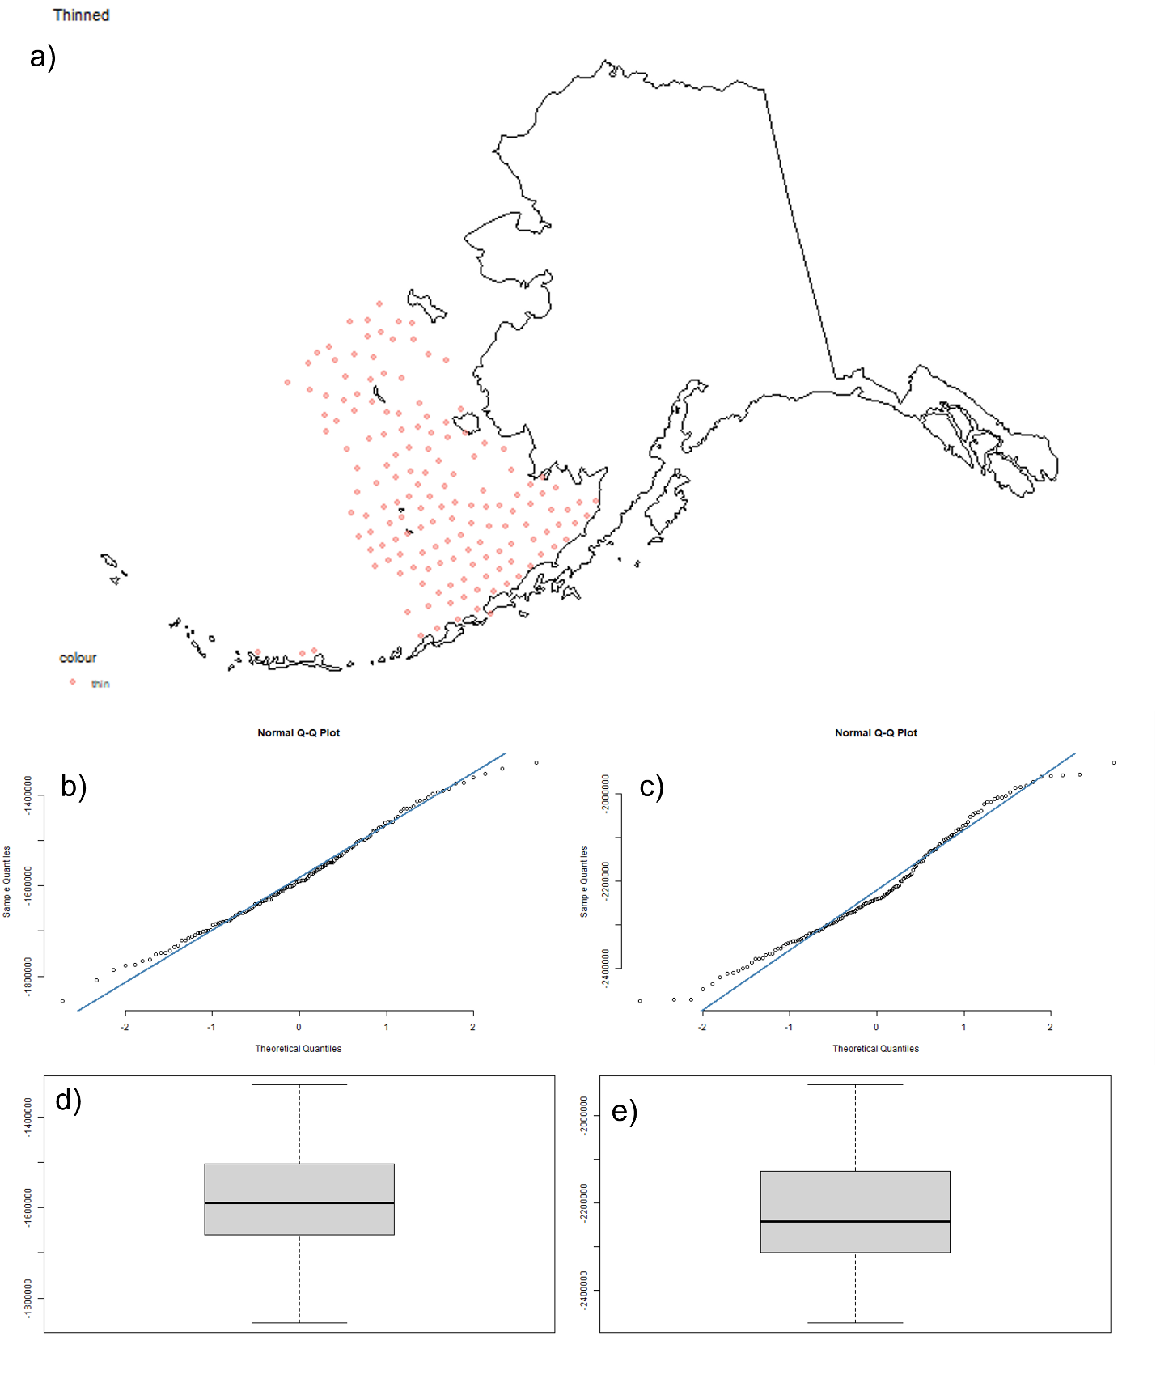
2007-2012
Notes:
Figure 7: a) 2007-2012 raw krill samples; b) x-coordinate QQ plot; c) y-coordinate QQ-plot; d) x-coordinate boxplot; e) y-coordinate boxplot. Shapiro-Wilk Normality Test: p(x)=1.8e-06; p(y)=2.2e-16.
Figure 8: a) 2007-2012 thinned krill samples; b) x-coordinate QQ plot; c) y-coordinate QQ-plot; d) x-coordinate boxplot; e) y-coordinate boxplot. Shapiro-Wilk Normality Test: p(x)=0.402; p(y)=0.0.00492.

Slide 9
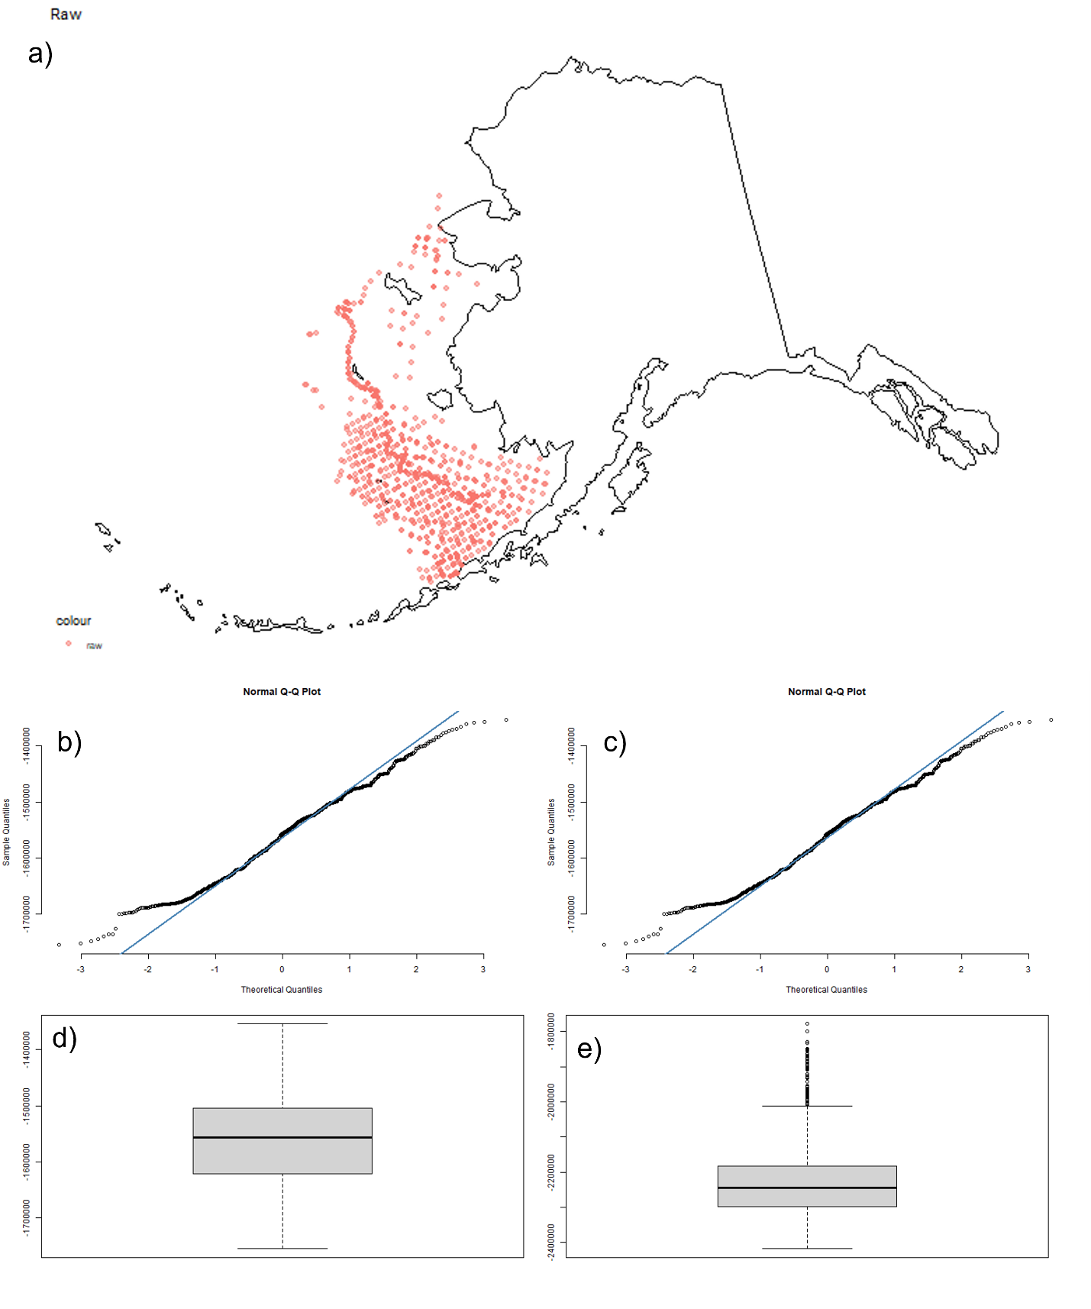
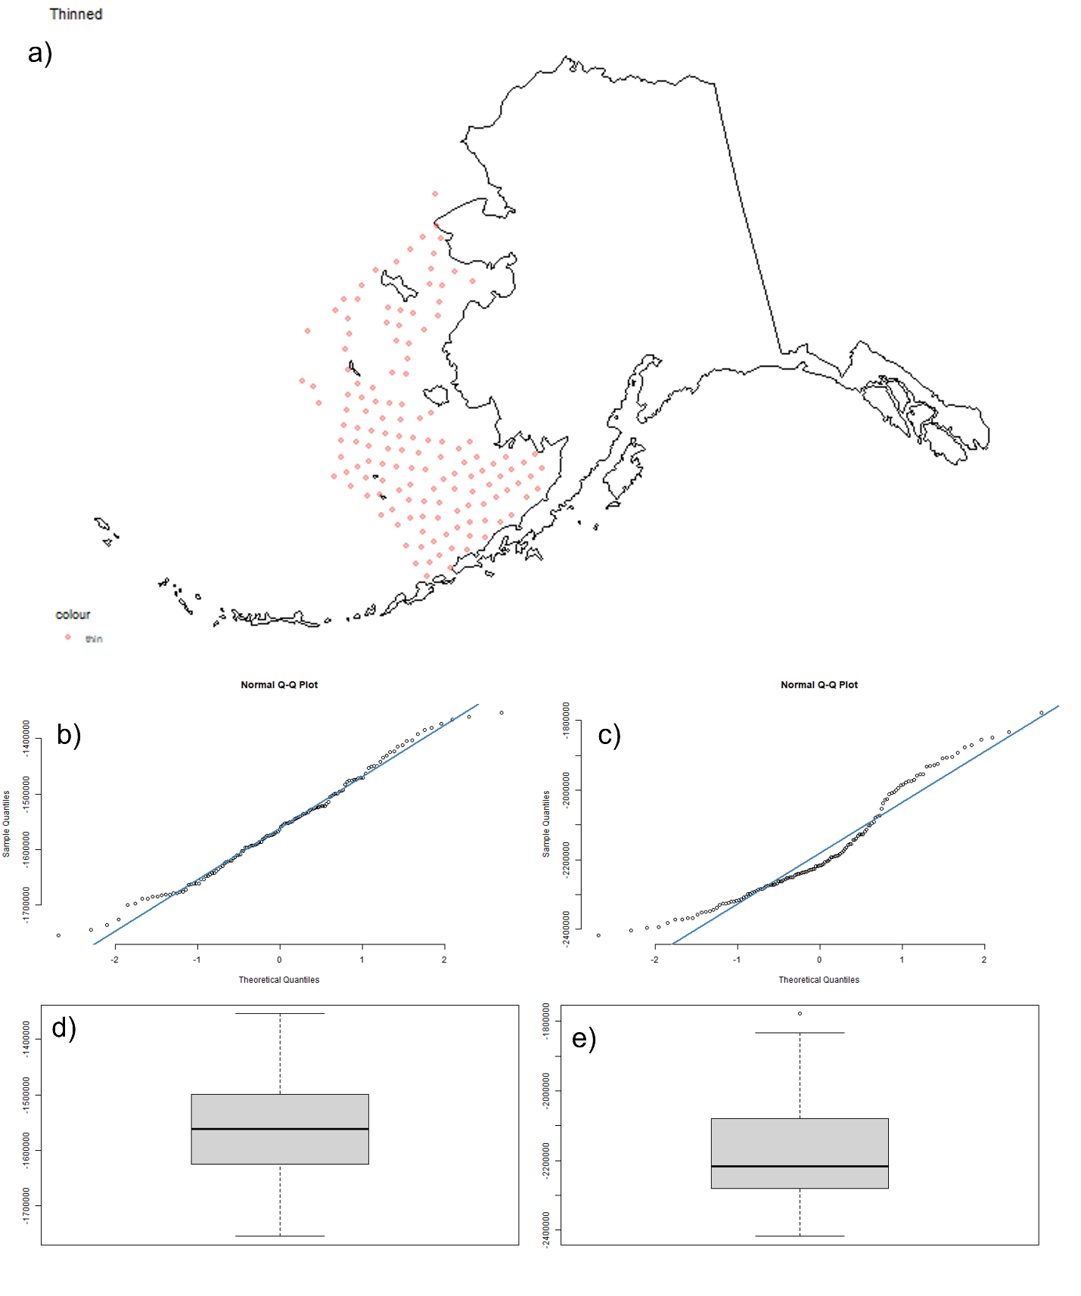
2013-2018
Notes:
Figure 9: a) 2013-2018 raw krill samples; b) x-coordinate QQ plot; c) y-coordinate QQ-plot; d) x-coordinate boxplot; e) y-coordinate boxplot. Shapiro-Wilk Normality Test: p(x)=4.492e-08; p(y)=2.2e-16.
Figure 10: a) 2013-2018 thinned krill samples; b) x-coordinate QQ plot; c) y-coordinate QQ-plot; d) x-coordinate boxplot; e) y-coordinate boxplot. Shapiro-Wilk Normality Test: p(x)=0.2078; p(y)=9.337e-06.
Overall, Krill sampling was verified to be spatially and temporally nonnormal (Figure 2-10). Binning and thinning data decreased autocorrelation and improved normality (Figure 2-10). Given that some samples remained nonnormal, the kernel density estimator (Figure 13), background surface, and predicted unbiased sample (Figure 20) in MaxEnt were used.

Slide 10
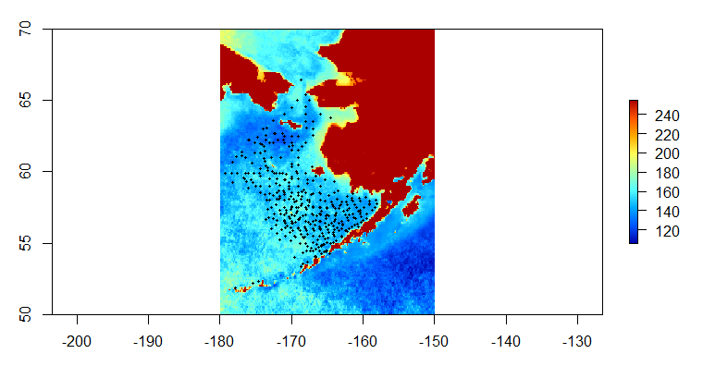
MaxEnt Model (1995-2018)
Predictors:
Chlorophyll A Concentration
Sea Surface Temperature
Bathymetry
Thinned krill distribution with average Chlorophyll A concentration
Notes:
Several MaxEnt models were developed to determine krill RORs based on the environmental covariates (sea surface temperature, chlorophyll A concentration, bathymetry). Data was manipulated and visualized using the following packages: raster, sp, rgdal, dismo, sp, and sm, ENMeval, colorRamps. Environmental covariates were aggregated such that 0.1 resolution was achieved, averaged across months of the years, stacked, and cropped to the Bering Sea extent. Sampling bias was handled using kernel density estimation and background points. A 0.25 test:train was supplied to the following models: 1) linear features, 2) default features, 3) linear features and sampling bias, 4) default features and bias corrected background. Models and environmental covariates were assessed and assumptions verified using the mean and standard deviation rasters, AIC, VIF, Boyce Index, AUC, omission and commission, sensitivity and specificity, covariate response curves, and variable contributions.
Figure 11: Thinned krill distribution (black) with average Chlorophyll A concentration as a raster background (colors).

Slide 11
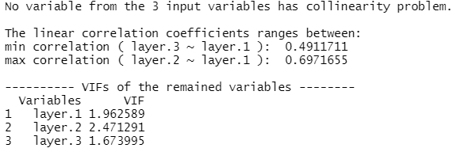
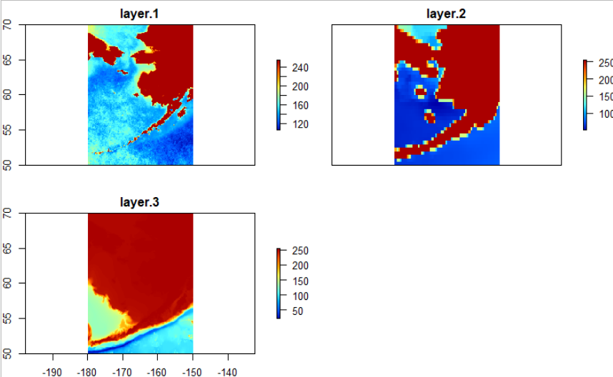
Check for Multicollinearity
Layers:
1) Chlorophyll A Concentration
2) Sea Surface Temperature
3) Bathymetry
Notes:
Figure 12: Variance Inflation Factors (VIFs) reported no multicollinearity with 1) chlorophyll A concentration (1.96), 2) sea surface temperature (2.47), bathymetry (1.67). Previously proposed variables were removed due to multicollinearity concerns.
layer1: chlorophyllA
layer2: sea surface temperature
layer3: bathymetry

Slide 12
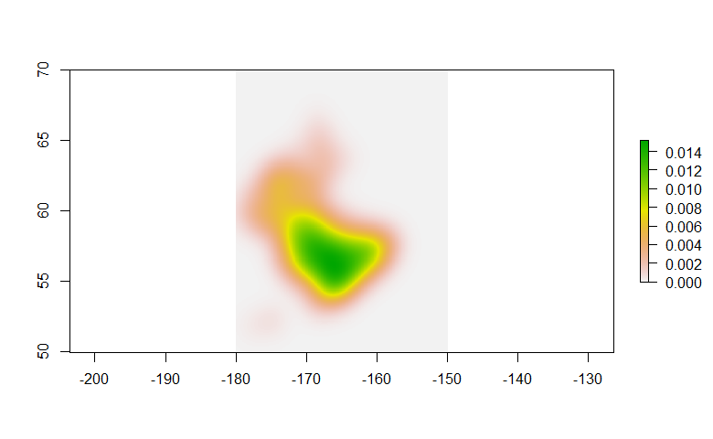
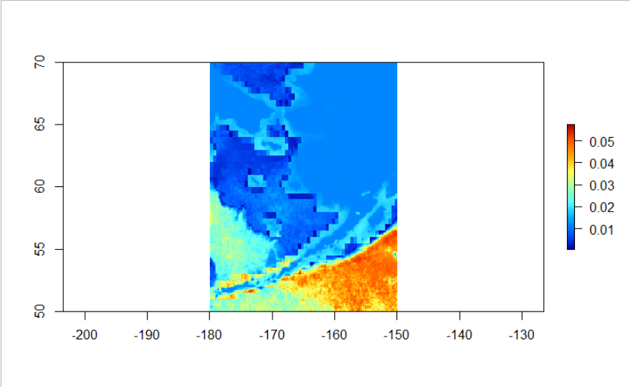
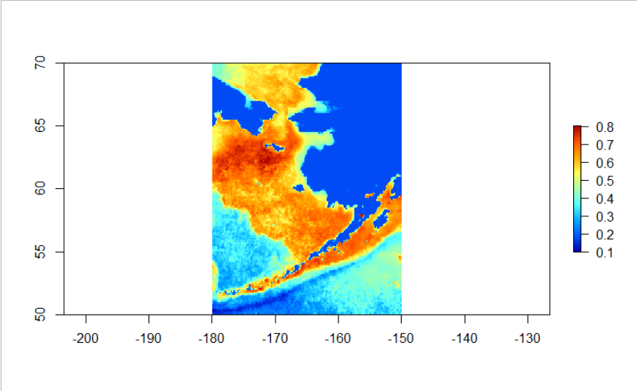
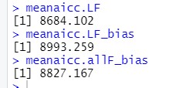
1995-2000
Notes:
Figure 13: Kernel density estimate raster.
Figure 14: Best performing (AIC: 8993.259) MaxEnt model with linear features and sampling bias (five iterations).
Figure 15: Standard deviation raster for Figure 14.
AICs for linear features, linear features with sampling bias, and all features with bias corrected background MaxEnt model.

Slide 13
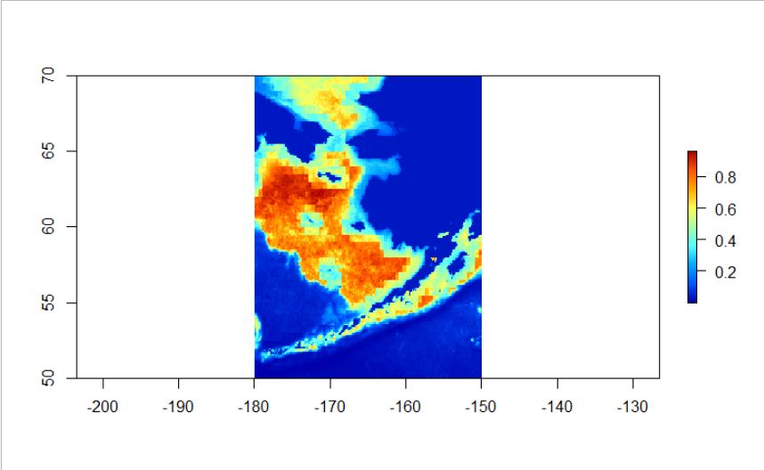
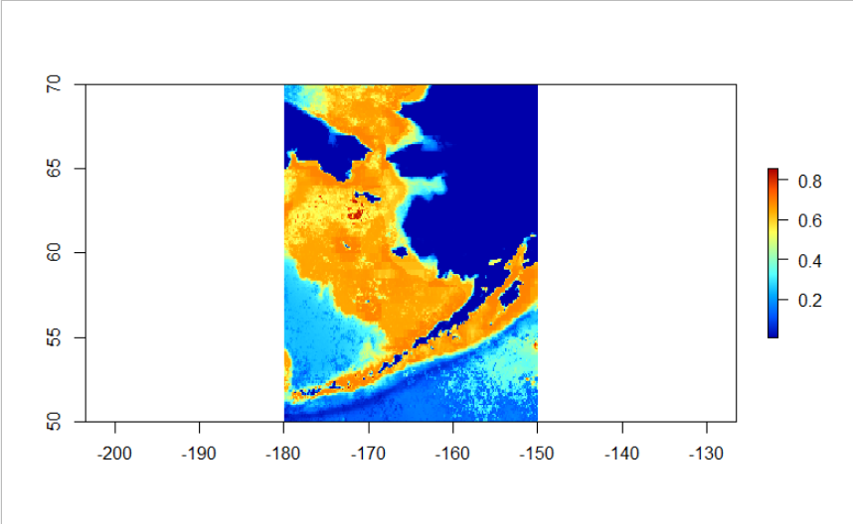
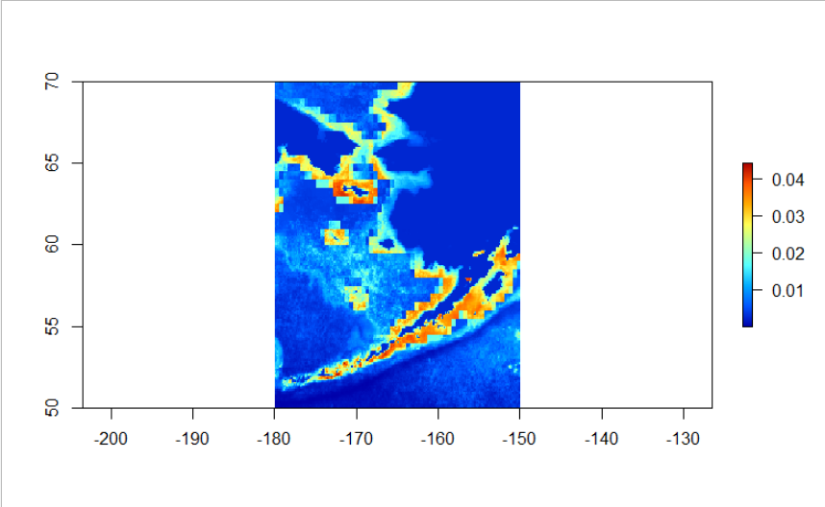
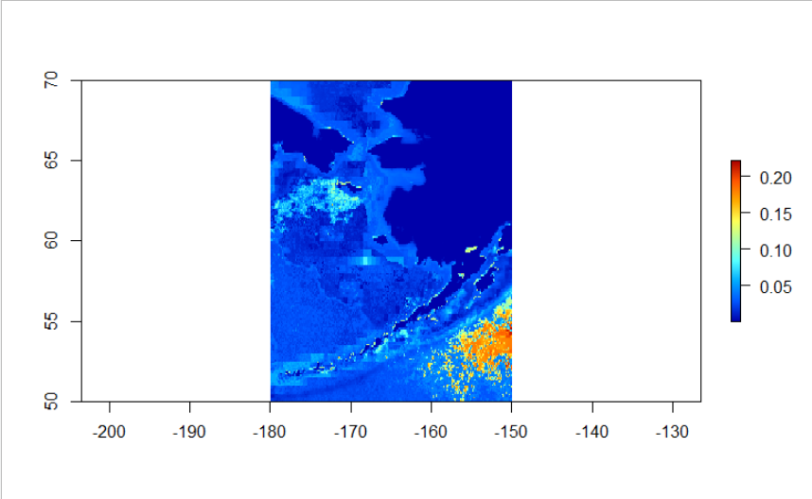
Linear Features
Default Features & Bias-Corrected Background
Linear Features & Sampling Bias
Standard Deviation
Standard Deviation
Standard Deviation
Notes:
Figure 16: MaxEnt linear features model (AIC: 8684.102).
Figure 17: Standard deviation for Figure 16.
Figure 18: Default features and bias corrected background MaxEnt model (AIC: 8827.167).
Figure 19: Standard deviation for Figure 18.
Figure 14: Best performing (AIC: 8993.259) MaxEnt model with linear features and sampling bias (five iterations).
Figure 15: Standard deviation raster for Figure 14.

Slide 14
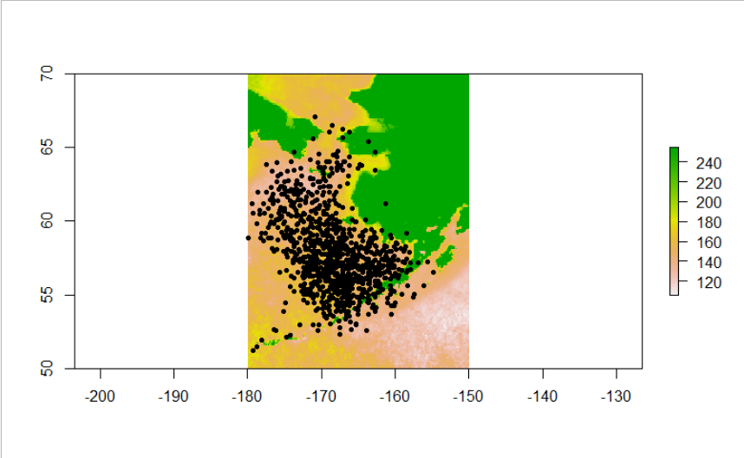
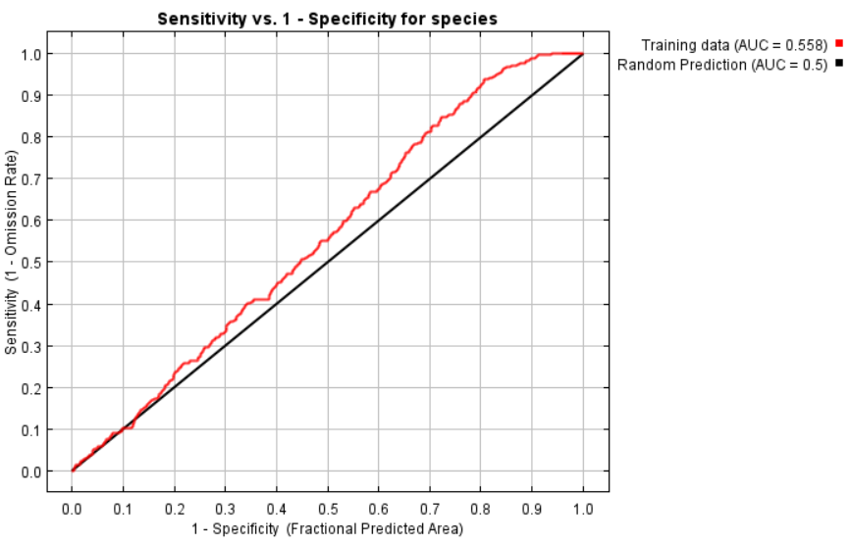
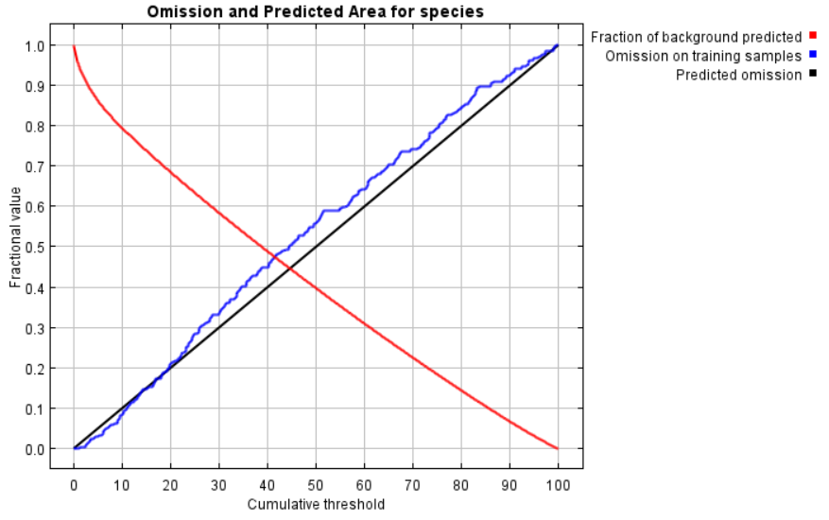


a)
c)
Estimated Underlying Sampling Bias
d)
b)
e)
Notes:
Best performing model:
Estimated underlying sampling bias
the omission rate and predicted area as a function of the cumulative threshold. The omission rate is is calculated both on the training presence records, and (if test data are used) on the test records. The omission rate should be close to the predicted omission, because of the definition of the cumulative threshold.
receiver operating characteristic (ROC) curve for the same data. Note that the specificity is defined using predicted area, rather than true commission (see the paper by Phillips, Anderson and Schapire cited on the help page for discussion of what this means). This implies that the maximum achievable AUC is less than 1. If test data is drawn from the Maxent distribution itself, then the maximum possible test AUC would be 0.584 rather than 1; in practice the test AUC may exceed this bound.
These plots reflect the dependence of predicted suitability both on the selected variable and on dependencies induced by correlations between the selected variable and other variables. They may be easier to interpret if there are strong correlations between variables.
The following table gives estimates of relative contributions of the environmental variables to the Maxent model. To determine the first estimate, in each iteration of the training algorithm, the increase in regularized gain is added to the contribution of the corresponding variable, or subtracted from it if the change to the absolute value of lambda is negative. For the second estimate, for each environmental variable in turn, the values of that variable on training presence and background data are randomly permuted. The model is reevaluated on the permuted data, and the resulting drop in training AUC is shown in the table, normalized to percentages. As with the variable jackknife, variable contributions should be interpreted with caution when the predictor variables are correlated.

Slide 15


Cold Pool
1980
2018
Notes:
The coldpool was identified by both the threshold value of temperatures at or below -1C (regardless of month) and using recolonization for binarized segmentation for verification of the edges (which tend to warm due to diffusion). Cold pool area is calculated using the raster image’s tiles and as a percent occupancy of the Bering Sea extent. The centroid describes the center of water mass of the cold pool, while the fragmentation index expresses the perimeter/surface area (higher values are more fragmented). A localized seasonal space-state model was constructed using the dlm package to determine changes in area from 1980-2018.
Figure 25: 1980 average bottom temperatures with cold pool (dark blue) by month. 1980-2018 plots are available, but Figures 25 and 26 provide a selection.
Figure 25: 2018 average bottom temperatures with cold pool (dark blue) by month.

Slide 16




Cold Pool Extraction
Notes:
Figure 26: Left: Recolorization of the bottom temperature based on rudimentary channel components. Right: monthly coldpool shapes for 1980.

Slide 17



Cold Pool
Notes:
Figure 28: Cold pool percent extent of SEBS. See interactive plot for details.
Figure 30: Cold pool fragmentation index (perimeter/surface area). See interactive plot.
Figure 29: Screenshot of cold pool centroid (xy-coordinates), color=year, size=fragmentation index.

Slide 18

Cold Pool Space State Model
Notes:
Figure 31: Cold pool space-state model depicting local level variation and a 12-month constant seasonal cycle. A statistically significant rise in area occurs from 2006-2013 and statistically significant decrease (p<0.05) from 2014-2018.

Slide 19
Discussion & Future Directions
Conclusions
Future Directions
When corrected for sampling bias, the maxent model predicts the highest krill distribution in the northwestern Bering Sea
Of the environmental covariates considered, Chlorophyll A concentration was the best predictor of krill distribution, followed by bathymetry and then sea surface temperature
The cold pool exhibits peak area in February-April and highest fragmentation in July-November
Over time and season, the cold pool centroid remains largely in the northwest, but percent extent has significantly increased in 2006-2013 and significantly decreased in 2014-2018
Use a fast Fourier transform (FFT) to determine seasonal trend
Run Maxent model for cold pool determined year groupings
Add additional time and coordinate-specific environmental covariates:
Wind
Surface Currents
Salinity
Notes:
Of the four MaxEnt models tested (Figures 11-23), the linear features with sampling bias model performed the best according to AIC and Boyce Index (Figures 14, 16, 18). The model predicts the highest krill RORs in the northwestern Bering Sea and this region’s coordinates partially overlap with the mean coldpool centroid across the 1980-2018 timeframe (Figures 14, 29). Of the environmental covariates considered in the model, Chlorophyll A was the best predictor of krill distribution, followed by bathymetry and finally sea surface temperature (Figure 23). Due to the averaging of seasons, it is possible that temperature lows and highs were not fully considered. In future analyses, it would be inciteful to complete grouping by months or seasons and reanalyze the covariates’ effects. Notably, the cold pool exhibits peak area in February-April (Figures 27, 28) and highest fragmentation in July-November (Figures 29, 30). As these cycles drive sea surface temperature, future models should incorporate seasonality and multiyear effects such as the significantly increased cold pool extent in 2006-2013 and significantly decreased extent in 2014-2018 (Figure 31). In future investigations, I hope to employ a fast Fourier transform to determine equations for seasonal and multiyear trends to replace the currently constant seasonal component (Figure 31), to test the effects of cold pool-based sample groupings on the Maxent model, and to improve the temporal resolution of the model such that it is possible to include wind, surface currents, and salinity. For the present model, the temporal resolution was too coarse to include these cyclic variables, as their annual averages flatten extremes captured in daily and hourly effects (Figures 32, 33 not included in the analysis).

Slide 20
Works Cited
Bi H.S., Yu H., Pinchuk A.I., Harvey H. R., 2015b. Interannual summer variability in euphausiid populations on the eastern Bering Sea shelf during the recent cooling event (2008-2010). Deep-Sea Research Part I-Oceanographic Research Papers, 95: 12-19.
Ciannelli L., Brodeur R.D., Napp J. M., 2004. Foraging impact on zooplankton by age-0 walleye pollock (Theragra chalcogramma) around a front in the southeast Bering Sea. Marine Biology, 144: 515-526.
Gaichas, S., Aydin, K., Francis, R.C. 2015. Wasp waist or beer belly? Modeling food web structure and energetic control in Alaskan marine ecosystems, with implications for fishing and environmental forcing. Progress in Oceanography, 138(A): 1-17.
Greene, C., Wiebe, P., Burczynski, J., and Youngbluth, M. 1988. Acoustical detection of high-density krill demersal layers in the submarine canyons off Georges Bank. Science, 241: 359-361.
Hunt Jr, G. L., Coyle, K. O., Eisner, L. B., Farley, E. V., Heintz, R. A., Mueter, F., Napp, J. M., et al. 2011. Climate impacts on eastern Bering Sea foodwebs: a synthesis of new data and an assessment of the Oscillating Control Hypothesis. ICES Journal of Marine Science, 68: 1230-1243.
Hunt, G. L., Coyle, K. O., Hoffman, S., Decker, M. B., and Flint, E. N. 1996. Foraging ecology of short-tailed shearwaters near the Pribilof Islands, Bering Sea. Marine Ecology-Progress Series, 141: 1-11.
Hunt, G. L., Ressler, P. H., Gibson, G. A., De Robertis, A., Aydin, K., Sigler, M. F., Ortiz, I., et al. 2016. Euphausiids in the eastern Bering Sea: A synthesis of recent studies of euphausiid production, consumption and population control. Deep-Sea Research Part Ii-Topical Studies in Oceanography, 134: 204-222.
Kimmel, D. G., Eisner, L. B., Wilson, M. T., and Duffy-Anderson, J. T. 2018. Copepod dynamics across warm and cold periods in the eastern Bering Sea: Implications for walleye pollock (Gadus chalcogrammus) and the Oscillating Control Hypothesis. Fisheries Oceanography, 27: 143-158.
Kristiansen, T., Stock, C., Drinkwater, K. F., and Curchitser, E. N. 2014. Mechanistic insights into the effects of climate change on larval cod. Global Change Biology, 20: 1559-1584.
Laurel, B. J., Cote, D., Gregory, R. S., Rogers, L., Knutsen, H., and Olsen, E. M. 2017. Recruitment signals in juvenile cod surveys depend on thermal growth conditions. Canadian Journal of Fisheries and Aquatic Sciences, 74: 511-523.
Moss, J. H., Farley, E. V., Feldmann, A. M., and Ianelli, J. N. 2009. Spatial Distribution, Energetic Status, and Food Habits of Eastern Bering Sea Age-0 Walleye Pollock. Transactions of the American Fisheries Society, 138: 497-505.
Nogueira, E., Batleb, J. M., Cabala, J., González-Nuevoa, G., Revillaa, R., Álvareza, E., and Buenoa, J. 2008. Accumulation of northern krill (Meganyctiphanes norvegica) in a convergence zone at the Cap Breton Canyon (southern Bay of Biscay). Revista de Investigacion Marina, 3: 225-226.
Okkonen, S. R., Schmidt, G., Cokelet, E., and Stabeno, P. 2004. Satellite and hydrographic observations of the Bering Sea ‘Green Belt’. Deep Sea Research Part II: Topical Studies in Oceanography, 51: 1033-1051.
Pinchuk, A. I., and Hopcroft, R. R. 2007. Seasonal variations in the growth rates of euphausiids (Thysanoessa inermis, T-spinifera, and Euphausia pacifica) from the northern Gulf of Alaska. Marine Biology, 151: 257-269.
Ressler, P. H., De Robertis, A., Warren, J. D., Smith, J. N., and Kotwicki, S. 2012a. Developing an acoustic survey of euphausiids to understand trophic interactions in the Bering Sea ecosystem. Deep Sea Research Part II: Topical Studies in Oceanography, 65: 184-195.
Santora, J. A., and Reiss, C. S. 2011. Geospatial variability of krill and top predators within an Antarctic submarine canyon system. Marine Biology, 158: 2527-2540.

Slide 21
Questions?

